Slide 1
B-Trees

Slide 2
Motivation for B-Trees
Index structures for large datasets cannot be stored in main memory
Storing it on disk requires different approach to efficiency
Assuming that a disk spins at 3600 RPM, one revolution occurs in 1/60 of a second, or 16.7ms
Crudely speaking, one disk access takes about the same time as 200,000 instructions

Slide 3
Motivation (cont.)
Assume that we use an AVL tree to store about 20 million records
We end up with a very deep binary tree with lots of different disk accesses; log₂ 20,000,000 is about 24, so this takes about 0.2 seconds
We know we can’t improve on the log n lower bound on search for a binary tree
But, the solution is to use more branches and thus reduce the height of the tree!
As branching increases, depth decreases

Slide 4
Definition of a B-tree
A B-tree of order m is an m-way tree (i.e., a tree where each node may have up to m children) in which:
1. the number of keys in each non-leaf node is one less than the number of its children and these keys partition the keys in the children in the fashion of a search tree
2. all leaves are on the same level
3. all non-leaf nodes except the root have at least ⎡m / 2⎤ children
4. the root is either a leaf node, or it has from two to m children
5. a leaf node contains no more than m – 1 keys
The number m should always be odd

Slide 5
An example B-Tree
26
A B-tree of order 5 containing 26 items
6
12
42
51
62
1
2
4
7
8
13
15
18
25
27
29
45
46
48
53
55
60
64
70
90
Note that all the leaves are at the same level

Slide 6
Constructing a B-tree
Suppose we start with an empty B-tree and keys arrive in the following order:1 12 8 2 25 5 14 28 17 7 52 16 48 68 3 26 29 53 55 45
We want to construct a B-tree of order 5
The first four items go into the root:
To put the fifth item in the root would violate condition 5
Therefore, when 25 arrives, pick the middle key to make a new root
1
2
8
12

Slide 7
Constructing a B-tree (contd.)
8
1
2
12
25
6, 14, 28 get added to the leaf nodes:
8
1
2
6
12
14
25
28

Slide 8
Constructing a B-tree (contd.)
Adding 17 to the right leaf node would over-fill it, so we take the middle key, promote it (to the root) and split the leaf
8
17
1
2
6
12
14
25
28
7, 52, 16, 48 get added to the leaf nodes
8
17
1
2
6
7
12
14
16
25
28
48
52

Slide 9
Constructing a B-tree (contd.)
Adding 68 causes us to split the right most leaf, promoting 48 to the root, and adding 3 causes us to split the left most leaf, promoting 3 to the root; 26, 29, 53, 55 then go into the leaves
3
8
17
48
1
2
6
7
12
14
16
25
26
28
29
52
53
55
68
Adding 45 causes a split of
25
26
28
29
and promoting 28 to the root then causes the root to split

Slide 10
Constructing a B-tree (contd.)
17
3
8
28
48
1
2
6
7
12
14
16
25
26
29
45
52
53
55
68

Slide 11
Inserting into a B-Tree
Attempt to insert the new key into a leaf
If this would result in that leaf becoming too big, split the leaf into two, promoting the middle key to the leaf’s parent
If this would result in the parent becoming too big, split the parent into two, promoting the middle key
This strategy might have to be repeated all the way to the top
If necessary, the root is split in two and the middle key is promoted to a new root, making the tree one level higher

Slide 12
Exercise in Inserting a B-Tree
Insert the following keys to a 5-way B-tree:
3, 7, 9, 23, 45, 1, 5, 14, 25, 24, 13, 11, 8, 19, 4, 31, 35, 56

Slide 13
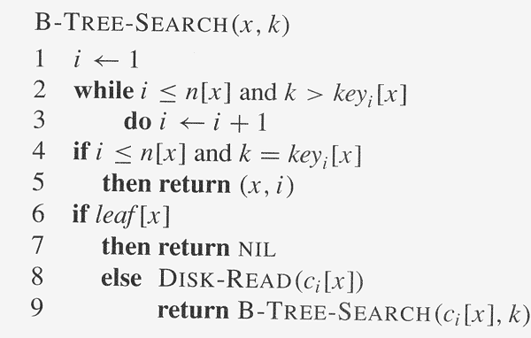

Slide 14
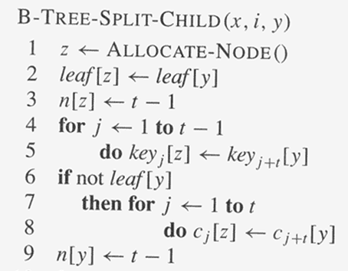

Slide 15
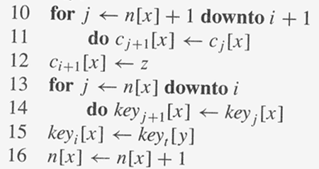

Slide 16
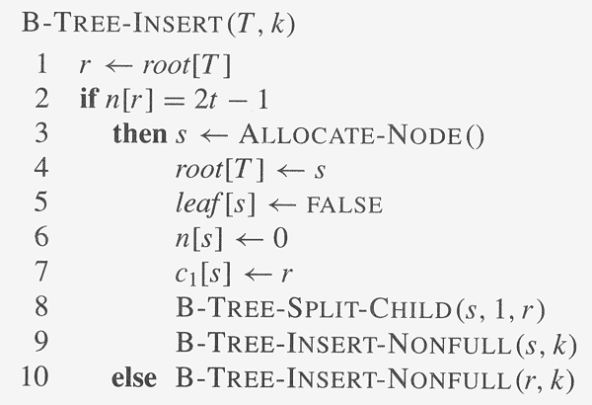
Copyright © The McGraw-Hill Companies, Inc. Permission required for reproduction or display.

Slide 17
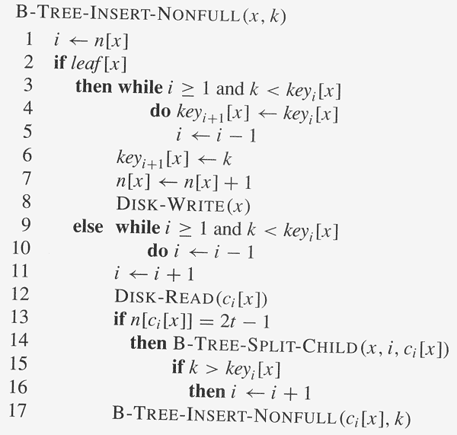
Copyright © The McGraw-Hill Companies, Inc. Permission required for reproduction or display.

Slide 18
Removal from a B-tree
During insertion, the key always goes into a leaf. For deletion we wish to remove from a leaf. There are three possible ways we can do this:
1 - If the key is already in a leaf node, and removing it doesn’t cause that leaf node to have too few keys, then simply remove the key to be deleted.
2 - If the key is not in a leaf then it is guaranteed (by the nature of a B-tree) that its predecessor or successor will be in a leaf -- in this case we can delete the key and promote the predecessor or successor key to the non-leaf deleted key’s position.

Slide 19
Removal from a B-tree (2)
If (1) or (2) lead to a leaf node containing less than the minimum number of keys then we have to look at the siblings immediately adjacent to the leaf in question:
3: if one of them has more than the min. number of keys then we can promote one of its keys to the parent and take the parent key into our lacking leaf
4: if neither of them has more than the min. number of keys then the lacking leaf and one of its neighbours can be combined with their shared parent (the opposite of promoting a key) and the new leaf will have the correct number of keys; if this step leave the parent with too few keys then we repeat the process up to the root itself, if required

Slide 20
Type #1: Simple leaf deletion
Assuming a 5-way
B-Tree, as before...
12
29
52
2
7
9
15
22
31
43
56
69
72
Delete 2: Since there are enough
keys in the node, just delete it

Slide 21
Type 2a: Simple non-leaf deletion
12
29
52
56
Delete 52
7
9
15
22
31
43
56
69
72
Borrow the predecessor
or (in this case) successor

Slide 22
Type 2b & 2c: Too few keys in node and its siblings
12
29
56
Join back together
7
9
15
22
31
43
69
72
Too few keys!
Delete 72

Slide 23
Type #2c: Too few keys in node and its siblings
12
29
7
9
15
22
31
43
56
69

Slide 24
Type #3a: Enough siblings
12
29
Demote root key and
promote leaf key
7
9
15
22
31
43
56
69
Delete 22

Slide 25
Type #3a: Enough siblings
12
31
7
9
15
29
43
56
69

Slide 26
Exercise in Removal from a B-Tree
Given 5-way B-tree created by these data (last exercise):
3, 7, 9, 23, 45, 1, 5, 14, 25, 24, 13, 11, 8, 19, 4, 31, 35, 56
Add these further keys: 2, 6,12
Delete these keys: 4, 5, 7, 3, 14

Slide 27
Reasons for using B-Trees
When searching tables held on disc, the cost of each disc transfer is high but doesn't depend much on the amount of data transferred, especially if consecutive items are transferred
If we use a B-tree of order 101, say, we can transfer each node in one disc read operation
A B-tree of order 101 and height 3 can hold 101⁴ – 1 items (approximately 100 million) and any item can be accessed with 3 disc reads (assuming we hold the root in memory)
If we take m = 3, we get a 2-3 tree, in which non-leaf nodes have two or three children (i.e., one or two keys)
B-Trees are always balanced (since the leaves are all at the same level), so 2-3 trees make a good type of balanced tree

Slide 28
Comparing Trees
Binary trees
Can become unbalanced and lose their good time complexity
AVL trees are strict binary trees that overcome the balance problem
Heaps remain balanced but only prioritise (not order) the keys
Multi-way trees
B-Trees can be m-way, they can have any (odd) number of children
One B-Tree, the 2-3 (or 3-way) B-Tree, approximates a permanently balanced binary tree, exchanging the AVL tree’s balancing operations for insertion and (more complex) deletion operations

